Slide 1

Community Schools Initiative
Loudoun County Public Schools

Slide 2
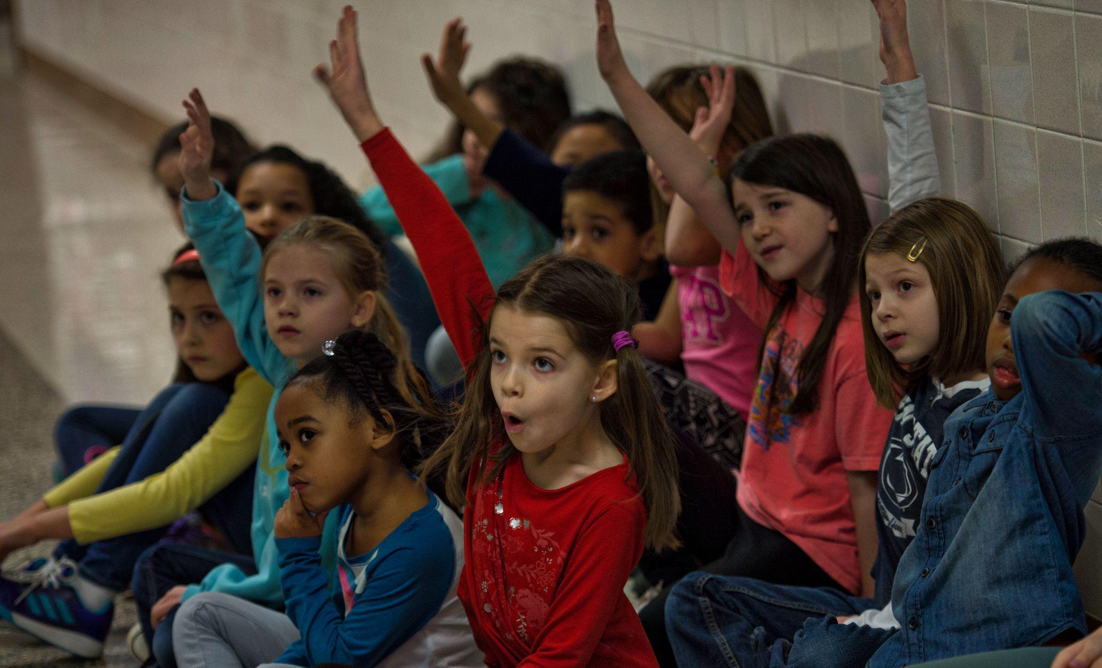
What is a Community School?
MISSION: A Community School is both a place and a set of partnerships between the school and other community resources. Its integrated focus on academics, health and social services, youth and community development and community engagement leads to improved student learning, strong families and healthier communities.
VISION: Placing students at the center of academic achievement, health and social supports and authentic family engagement to ensure shared ownership and investment by the community in the lives of its youngest members.
Notes:
Saraha

Slide 3
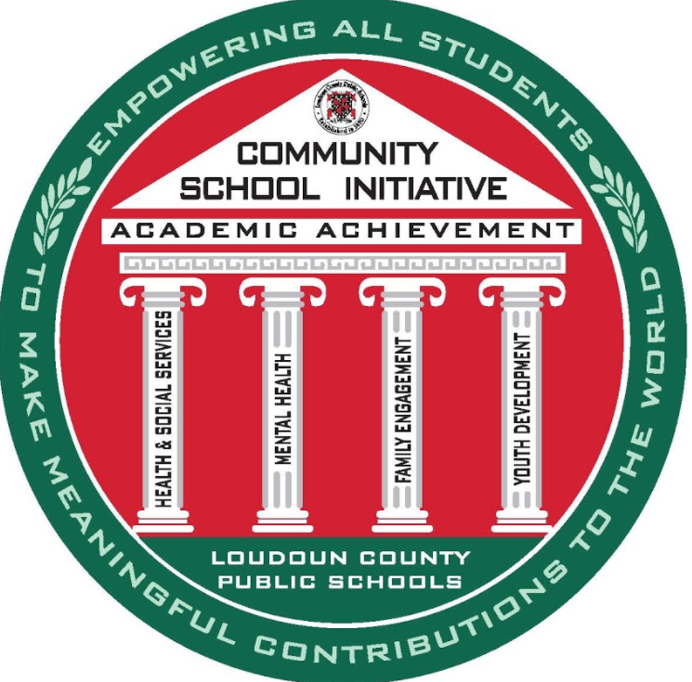
LCPS Community Schools Model
Focus is on Academic Achievement
Four pillars support academic achievement and the whole child
PILLARS INCLUDE:
Health and social services
Mental health
Family engagement
Youth development
Notes:
Sarah

Slide 4
History and Background
Began at Sterling Elementary School in 2015
In 2018, expanded to all six Title I elementary schools within LCPS
In 2019, full-time Community Schools Parent Liaisons at each school
In 2020, LCPS held a summit with Dr. George White, founder of CS in PA to help align the Community School Initiative
In 2021, Community School Initiative expanded staffing to include:
3 additional full-time School Social Workers (for a total of 6)
6 full-time School Nurses
Notes:
Sarah

Slide 5






Our Community Schools
Sterling Elementary School
Guilford Elementary School
Sully Elementary School
Sugarland Elementary School
Rolling Ridge Elementary School
Forest Grove Elementary School
Notes:
Julie

Slide 6
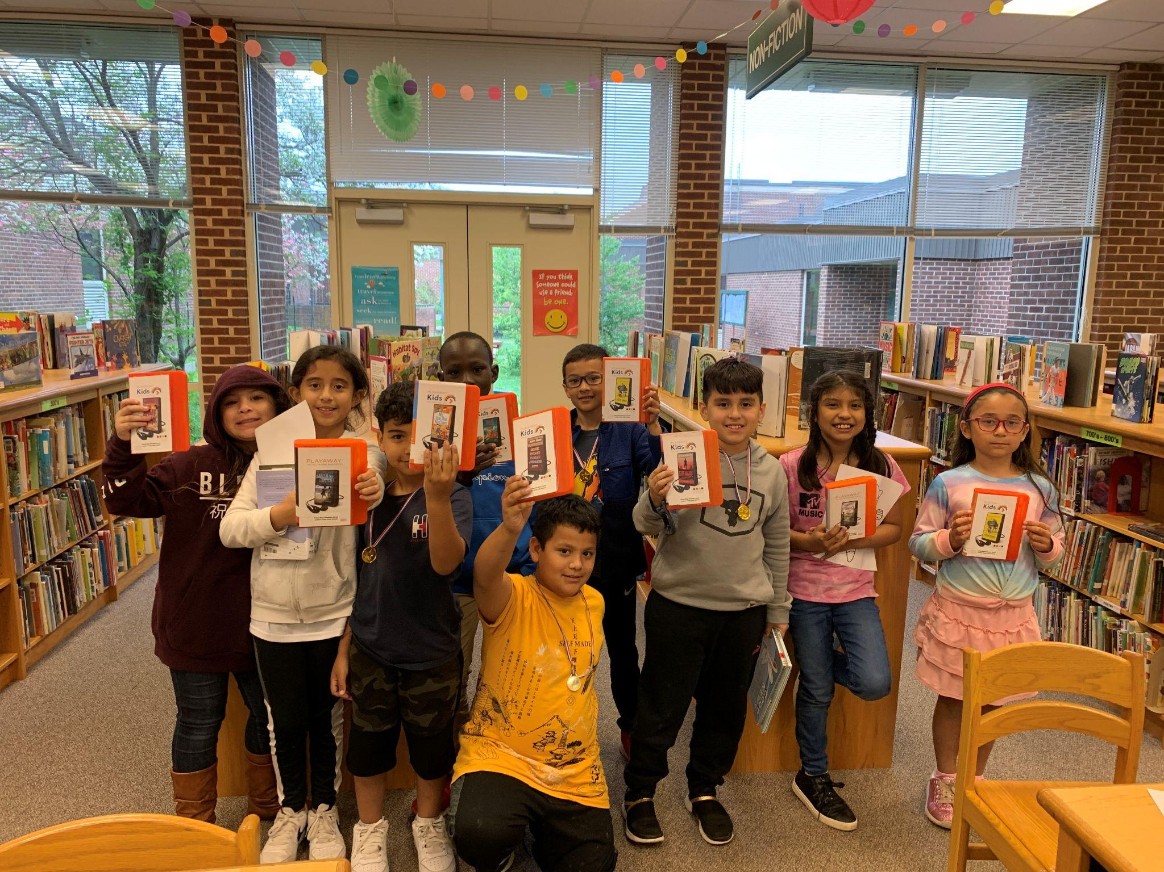
Demographics of our Community Schools
3,028 students enrolled
74% of students are economically disadvantaged
69% English Language Learners
337 students are homeless
9% of students have disabilities
Data from 2021-2022 school year
Notes:
Julie

Slide 7
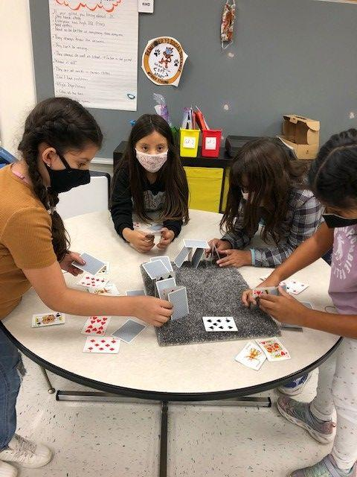
Community School Success
81% of students have an attendance
rate of 90% or higher
94% of students had no discipline incidents within the first three marking periods
87% of students feel like they belong in their school
94% of families feel that their school provides multiple opportunities for family engagement in school activities
94% of students feel they have a teacher or other adult at school they can talk with if they need help with something.
Data from 2021-2022 school year
Notes:
Sarah

Slide 8
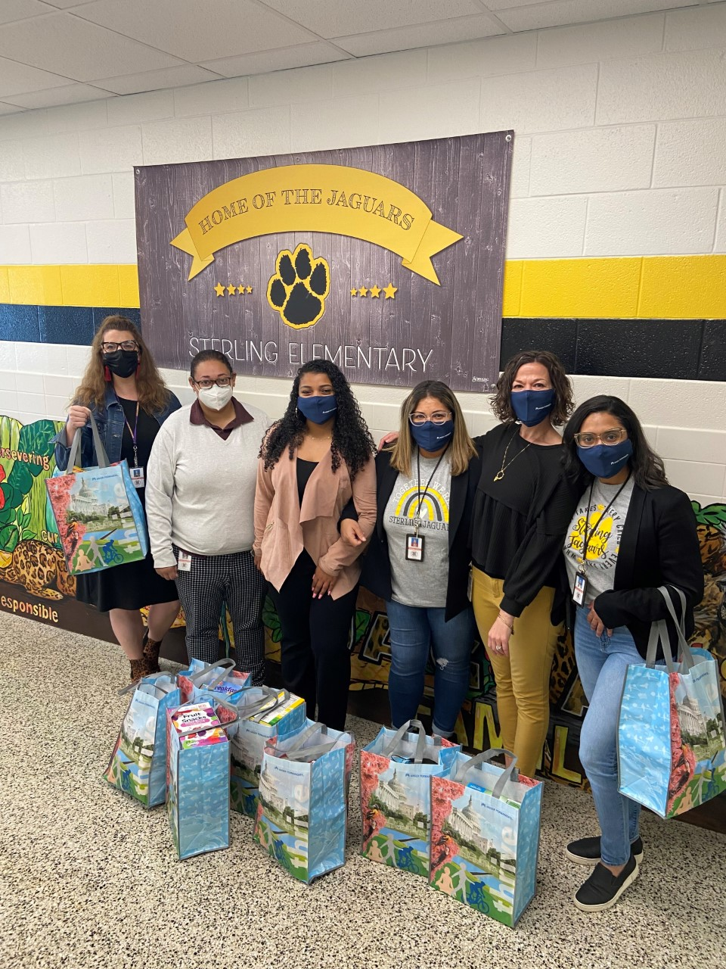
Health and Social Services
All schools are provided weekend meal programs
Many offer food pantries
Loudoun Hunger Relief mobile bus
Snacks
All schools provide clothing and winter coats
On-campus clothing closets
Family resource fairs
Dental Clinic through Tree of Life
Referrals for healthcare, vision assistance, diapers, housing and utility assistance, etc.
Notes:
Julie

Slide 9

Youth Development
Girls Rule the Court tennis
Loudoun Soccer
INOVA Healthy Plate Club
Girls on the Run
Readers are Leaders
PROPEL
Math after-school club
Dance club
Basketball club
Drama club
Hydroponics club
Watchdog Dads
Notes:
Julie

Slide 10

Family Engagement
Family Resource Fairs
Family technology classes and individual assistance
Adult ESL classes
Parents as Educational Partners (PEP) classes
School Advisory Council
Family Coffee Nights
Virtual home visits
Notes:
Sarah

Slide 11
Mental Health
Thanks to the generosity of 100WomenStrong, the community was able to see the impact of having a full-time social worker.
Full-time School Social Workers are now at each Community School effective 2021-2022 School Year
Unified Mental Health Team members will be reaching out to at-risk students and families this summer to “check in.”
For 2022-2023, LEF is raising funds to provide music therapy program to the Community Schools.
Notes:
Danielle

Slide 12
Testimonials from Principals
JENNIFER SHORT, PRINCIPAL, STERLING ELEMENTARY:
“Words can’t express the impact our full-time school social worker has on our Sterling Elementary community. Her expertise is unlike any others’ within our school community. While she counsels students, assists families in securing resources, and guides families in navigating difficulties with mental health, basic resources, and other needs they may encounter, her level of expertise guides our conversations and the way we support our families. She’s a valuable member of our Unified Mental Health Team and case manages many of our families. Unfortunately this school year in particular, our students’ mental health needs have intensified in a way we have never seen. Additionally, needs of their family members have also intensified. Ms. Garcia is invaluable, and we are so grateful to have her as a full-time member of our school team. I can’t imagine how we would navigate this road for our students and their families without her.”
ABBY SACCO, PRINCIPAL, ROLLING RIDGE ELEMENTARY:
“Our school social worker is a valuable part of our school community. Having her on staff full time has benefited our students and families immensely. She is available to students, families, and staff for day to day support and when more serious situations arise. She is a collaborative member of our UMHT team. We are so appreciative to have her at Rolling Ridge full time.”
RHONDA LOPEZ, PRINCIPAL, FOREST GROVE ELEMENTARY:
“Having our full time social worker has been an incredible asset to our school community. Melissa is not only available for student mental health needs, but she is also instrumental in our community schools initiatives in providing resources and supports for families, identifying areas where different supports are needed and organizing community events. The social workers have the expertise and knowledge to help bridge the gap between the community and the schools.”
Notes:
Danielle

Slide 13

LEF Support
$6,700 raised to support after school programming
$8,000 raised to support Parent as Educational Partners Program
LEF created a position, Program Coordinator, dedicated to collaborating with the community and LCPS to support the needs of the Community Schools
Community Schools have been spotlighted in many LEF communications, including the e-newsletter, blog, social media posts to raise awareness and support for the program.
-
Notes:
Danielle

Slide 14




























Community Partnerships
Notes:
We rely heavily on community partners to support our Community Schools! CCertainly not an exhaustive list, but these are some of our regular partners. We are so thankful for their support.

Slide 15


Slide 16
Sarah Eaton
Supervisor, Outreach Services
Loudoun County Public Schools
sarah.eaton@lcps.org
Danielle Nadler Executive Director
Loudoun Education Foundation
danielle.nadler@lcps.org
Julie Sproul
Programs Coordinator
Loudoun Education Foundation
julianna.sproul@lcps.org

